Slide 1

Mandhana, Kanpur
Science Exhibition Project
Heart Beat Sensor Using
Arduino

Slide 2
Introduction
Monitoring heart rate is very important for athletes, patients as it determines the condition of the heart (just heart rate). There are many ways to measure heart rate and the most precise one is using an Electrocardiography
But the more easy way to monitor the heart rate is to use a Heartbeat Sensor. It comes in different shapes and sizes and allows an instant way to measure the heartbeat.
Heartbeat Sensors are available in Wrist Watches (Smart Watches), Smart Phones, chest straps, etc. The heartbeat is measured in beats per minute or bpm, which indicates the number of times the heart is contracting or expanding in a minute.

Slide 3
Principle
The principle behind the working of the Heartbeat Sensor is Photoplethysmograph. According to this principle, the changes in the volume of blood in an organ is measured by the changes in the intensity of the light passing through that organ.
Usually, the source of light in a heartbeat sensor would be an IR LED and the detector would be any Photo Detector like a Photo Diode, an LDR (Light Dependent Resistor) or a Photo Transistor.
With these two i.e. a light source and a detector, we can arrange them in two ways: A Transmissive Sensor and a Reflective Sensor.
In a Transmissive Sensor, the light source and the detector are place facing each other and the finger of the person must be placed in between the transmitter and receiver.
Reflective Sensor, on the other hand, has the light source and the detector adjacent to each other and the finger of the person must be placed in front of the sensor.

Slide 4
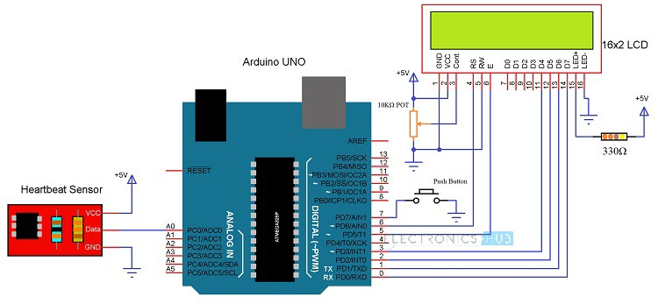
Circuit of Arduino based Heart Rate Monitor using Heartbeat Sensor The following image shows the circuit diagram of the Arduino based Heart Rate Monitor using Heartbeat Sensor. The sensor has a clip to insert the finger and has three pins coming out of it for connecting VCC, GND and the Data.

Slide 5
Components Required:-
Arduino UNO x 1
16 x 2 LCD Display x 1
10KΩ Potentiometer
330Ω Resistor (Optional – for LCD backlight)
Push Button
Heartbeat Sensor Module with Probe (finger based)
Mini Breadboard
Connecting Wires

Slide 6
Working
Upload the code to Arduino UNO and Power on the system. The Arduino asks us to place our finger in the sensor and press the switch.
Place any finger (except the Thumb) in the sensor clip and push the switch (button). Based on the data from the sensor, Arduino calculates the heart rate and displays the heartbeat in bpm.
While the sensor is collecting the data, sit down and relax and do not shake the wire as it might result in a faulty values.
After the result is displayed on the LCD, if you want to perform another test, just push the rest button on the Arduino and start the procedure once again.

Slide 7
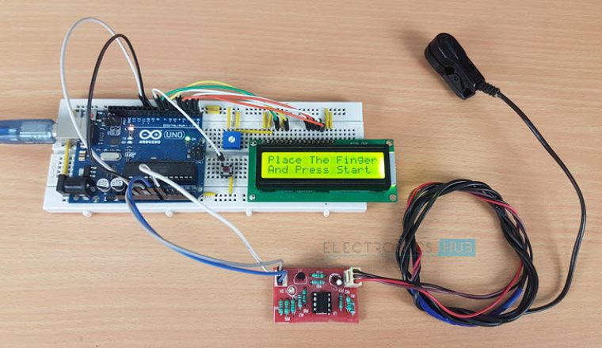
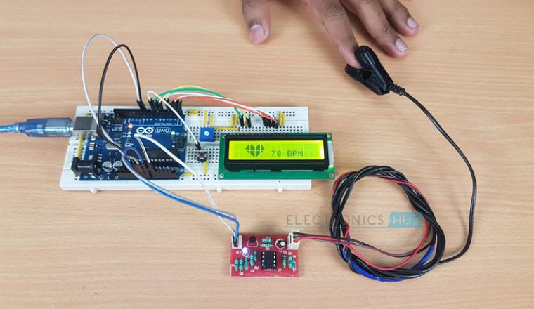
Circuit Design of Interfacing Heartbeat Sensor with Arduino The circuit design of Arduino based Heart rate monitor system using Heart beat Sensor is very simple. First, in order to display the heartbeat readings in bpm, we have to connect a 16×2 LCD Display to the Arduino UNO. The 4 data pins of the LCD Module (D4, D5, D6 and D7) are connected to Pins 1, 1, 1 and 1 of the Arduino UNO. Also, a 10KΩ Potentiometer is connected to Pin 3 of LCD (contrast adjust pin). The RS and E (Pins 3 and 5) of the LCD are connected to Pins 1 and 1 of the Arduino UNO. Next, connect the output of the Heartbeat Sensor Module to the Analog Input Pin (Pin 1) of Arduino.

